Slide 1


Planning Policy briefing
27/02/2024

Slide 2
Agenda
West Northamptonshire Local Plan Update
Settlement Hierarchy
Questions

Slide 3
Local Plan
Steps in Plan Preparation – what has happened so far?
Consultation on a strategic plan to 2050
Issues Consultation (2019)
Scope and Issues
Options Consultation (2021):
Vision and Objectives
Identified potential locations for housing (30k) and economic development (48ha) across West Northants
11,000 comments (reported to committee in June 2022)

Slide 4
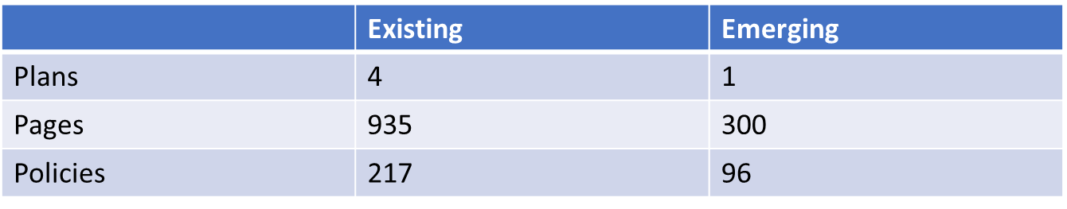
Local Plan
Now working on approach which:
Has a shorter time frame: to 2041 rather than 2050
Includes all policies in a single plan rather than in two parts. Plus neighbourhood plans
Seeks to increase opportunities for development in our centres to assist in urban renewal and reduce need for new greenfield sites.

Slide 5
Local Plan
Regulation 18 draft Plan
Plan will contain a spatial strategy
A suite of policies on a variety of topics
Strategic policies for Neighbourhood Planning
Some housing and employment allocations
Some policies are in development
Evidence base documents support the emerging plan

Slide 6
Local Plan
Policy Committee and Council in March
Agenda published w/c 4th March.
Public consultation on the current draft April/May
You will be written to.
Also a call for sites, including local green space.

Slide 7
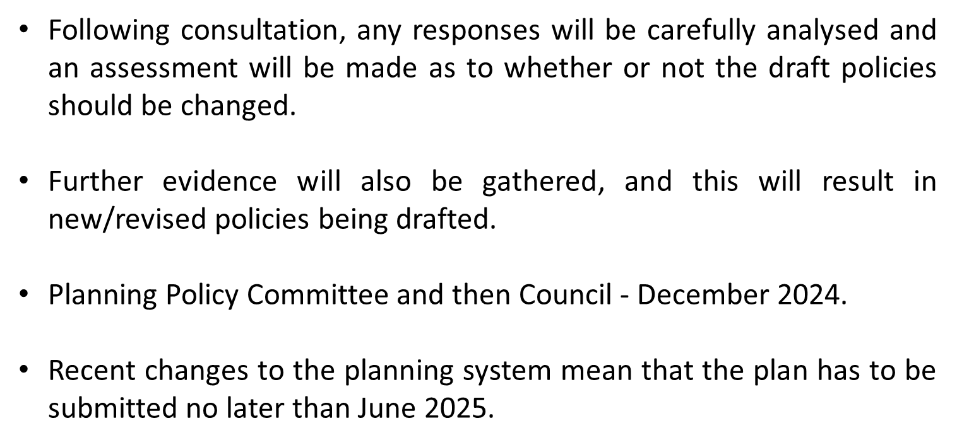
Local Plan

Slide 8
Settlement Hierarchy
Notes:
Those Parishes with settlements identified in the current plans will have received some engagement documents and questions from us last week about the settlement hierarchy.
The next slides will talk to that
There are a small number of Parishes that have received an alternative consultation, they will know who they are, separate briefing after this session.

Slide 9
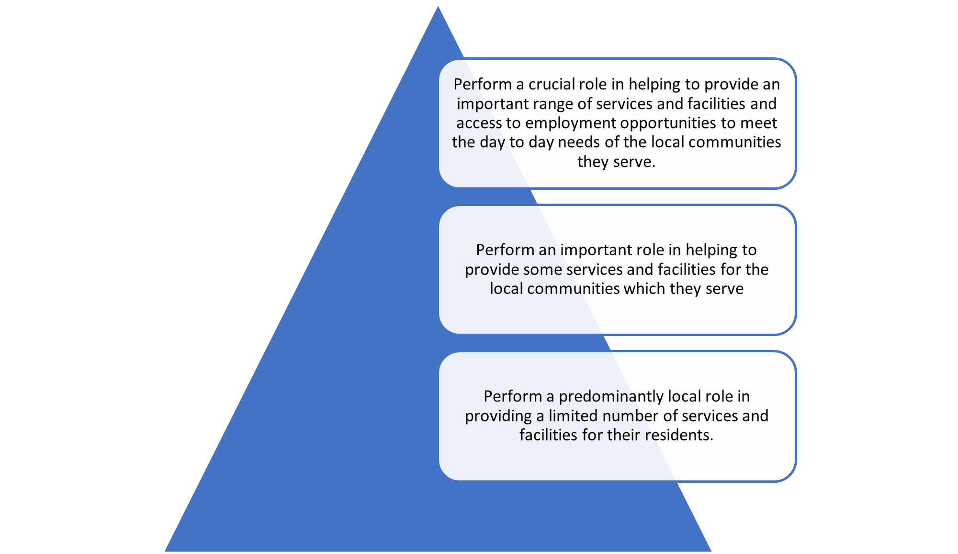
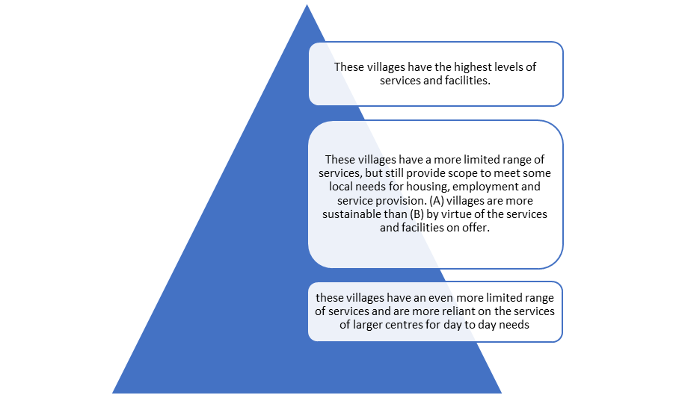
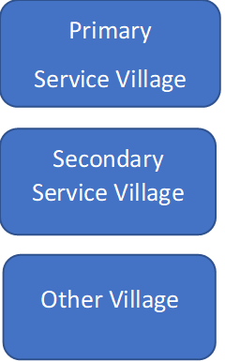
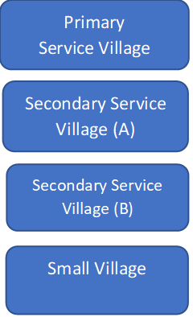
Settlement Hierarchy
Budget update…
Existing Daventry Hierarchy
Existing South Northants Hierarchy
Smaller settlements or Hamlets, which have little or no service provision are not included in the hierarchy, but are identified in the Part 2 Local Plans.
Notes:
A settlement hierarchy is a way of categorising settlements based on factors such as the range of services and facilities they provide and access to public transport. The purpose of a settlement hierarchy is to help direct new development to the most sustainable locations.
To clarify – talking about settlements smaller than Northampton, Daventry, Towcester & Brackley
As you are aware, existing Planning Policy for West Nortamptonshire comprises the Joint Core Srategy which sets the overarching strategic polices and that is supplemented by the part 2 local plans for the former administrative areas. JCS set a framework for the settlement hierarchy but left it to the Part 2 plans to decide their own methodologies for which settlement should go in which tier.
You will probably be familiar with the categories that we currently use for settlement – Primary Service Village, Secondary Service Villages and Other or Small Villages and the part 2 plans have policies which guide development for each of those tiers. Hamlets, which are the smallest category of settlement are not in the hierarchy and are considered open countryside in the current plans.
The Part 2 Local Plans for the former Daventry and South Northamptonshire areas took slightly different approaches to the settlement hierarchies for the smaller settlements in their rural areas, as shown here, with SN splitting the SSVs and having slightly different definitions. The methodologies for determining which settlement falls within each tier varied in terms of the types of services and facilities that were considered.
The new Local Plan will need to establish a single hierarchy for the whole of West Northamptonshire which will inform new planning policies to guide future development in the rural areas. We need to harmonise the definitions for each tier, and the methodology for which services and facilities are considered. We need the input from Parishes to help inform this so we are asking you about your experience in the tier you’re in currently as well as what sorts of services and facilities you think should be included.

Slide 10
Settlement Confines
Two separate sets of criteria for defining settlement confines
Broadly the same, except for one key difference: Rural exception sites.
Daventry criteria excludes exception sites from settlement confines
South Northants criteria includes exception sites within settlement confines
Confines are drawn for all settlements in South Northants
Confines are not currently drawn for Daventry’s ‘Other villages’
Notes:
Settlement or village confines represent the extent of a settlement’s main built up area and where certain policies apply. Confines are only applied to settlements in the hierarchy – Primary, Secondary & Small/Other.
Hamlets do not have confines drawn. We are not currently suggesting that this will change so those with just hamlets have not been sent the confines paper.
The two sets of criteria are broadly similar, except for how they treat Rural Exception sites – Daventry = excluded & South = included
Officers have drafted some suggested new settlement confines criteria, which we would like your thoughts on.
The types of settlements which have their confines mapped also differs in the former Daventry and South Areas. Currently, Daventry’s Other Villages do not have confines drawn (unless they have been defined in a Neighbourhood Plan) and they are only determined, according to the criteria in the Part 2 Local Plan, when necessary as part of determining planning applications.

Slide 11
Engagement with Parish Councils
Explanatory documents and response forms sent via email on 22nd February
  Experience of existing hierarchy
  Services & Facilities audit
  Future aspirations
  Settlement confines (where applicable)
Please respond by 2nd April 2024
localplan@westnorthants.gov.uk
Notes:
All Parishes with a settlement defined in one of the existing Part 2 Plans should have received an email from the Local Plan team with documents
Asking open questions about:
Existing hierarchy
Future aspirations for your Parish
Settlement confines – suggested new criteria. Settlement confines are not drawn for Hamlets and we are not proposing to change that, but we would like to update Services and Facilities
We would like your help with updating the evidence on the services and facilities you have in your settlements.
Please send any queries and your responses to local plan email.

Slide 12
Questions
Notes:
Clarify this is about all settlements below Northampton, Daventry, Brackley & Towcester
Today’s session will cover:
Existing Settlement Hierarchy policies and the issues to be overcome to achieve a single hierarchy for West Northants
Existing approaches to Settlement Confines and issues to be overcome to define a new approach for West Northants
New boundary for Northampton and implications for the settlements surrounding the urban area
Proposed engagement with Parishes, particularly how to approach those affected by the Northampton boundary change.

