Slide 1


Community Infrastructure Levy and Section 106

Slide 2
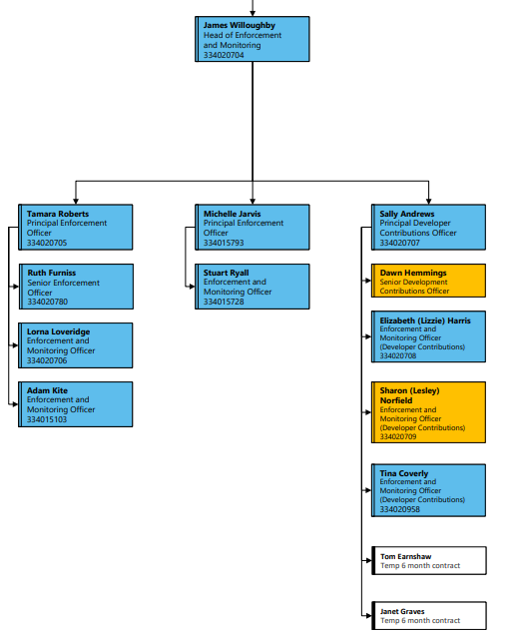
THE TEAM

Slide 3
WHAT IS CIL
The Community Infrastructure Levy (CIL) is a planning charge, introduced by the Government through the Planning Act 2008 to provide a fair and transparent means for ensuring that development contributes to the cost of the infrastructure it will rely upon, such as schools and roads. The levy applies to most new buildings and charges are based on the size and type of new floorspace.

Slide 4
WHAT IS A S106 AGREEMENT
Section 106 Agreements are formal Deeds made pursuant to Section 106 of the Town and Country Planning Act 1990 (“the Act”) to secure planning obligations which are required in order to make a proposed development acceptable in planning terms. The idea is that the planning obligations mitigate the impact of a proposed development.

Slide 5
EXAMPLES OF S106 OBLIGATIONS INCLUDE
A requirement to provide on-site affordable housing
A requirement to pay a sum of money towards the provision of affordable housing off site
A requirement to provide community facilities such as a youth centre on site
A requirement to provide access roads or to improve junctions

Slide 6
HOW CIL AND S106 DIFFER
CIL and S106 agreements are separate infrastructure funding sources.
S106 agreements address site-specific mitigation required to make a new development acceptable in planning terms.
Whilst CIL addresses the broader impacts of the development.
Some developments may attract both CIL liability and S106 obligations. But there should be no circumstances where a developer is paying CIL and S106 for the same infrastructure in relation to the same development.

Slide 7
DEVELOPMENTS LIABLE FOR CIL
Creates a new dwelling of any size; or
Creates over 100sqm of gross internal floorspace (new build), before making deductions for existing floorspace that is to be demolished; and
Involves buildings into which people normally go.

Slide 8
HOW WNC COLLECT CIL
Summary of the CIL process
The process outlined below will apply in the majority of cases, however, there may be circumstances where the process differs, such as liability for Permitted Development.
Application
If planning permission is required for the development, you must provide the Additional Information Form to allow us to calculate the CIL.
If your development is permitted development (does not require planning permission), you must submit a Notice of Chargeable Development (CIL form 5). If this is not submitted, we will prepare the notice and serve it on the owner.
Determination
During the life time of the application you must submit an Assumption of Liability (CIL form 2).
If liability changes before final payment becomes due, a Withdrawal or Transfer of Assumed Liability (CIL form 3 or 4) must be submitted.

Slide 9
CIL COLLECTION
When development commences, you must submit a commencement notice to inform us. If no one has assumed liability by the time development commences, liability passes to the landowner.
When we have received the commencement notice, we will issue a Demand Notice to the persons who have assumed liability for paying CIL.
The notice will set out the date that CIL must be paid by (in most cases, you will have at least 60 days to pay from the date of commencement). Where instalments apply, the Demand Notice will set out the amount due in each instalment and the date it must be paid by.

Slide 10
ARE ALL DEVELOPMENTS CIL CHARGABLE
It is possible a development is liable for CIL, however there is a wide criteria available that would mean the development can claim an exemption for CIL.
Residential annexes and extensions where an exemption has been applied for and obtained prior to commencement of the development.
Self-build’ houses and flats, which are built by ‘self-builders’ where an exemption has been applied for and obtained prior to commencement of the development.
Social housing that meets the relief criteria set out in regulation 49 or 49A (as amended by the 2014 Regulations), the 2015 Regulations and the 2020 (No. 2) Regulations) and where an exemption has been applied for and obtained prior to commencement of the development.
Charitable development that meets the relief criteria set out in regulations 43 to 48 and where an exemption has been applied for and obtained prior to commencement of the development.
It can be misunderstood if a development is exempt that forms don’t need to be filled in which can be a costly mistake!

Slide 11
HOW IS CIL MONIES SPENT/ALLOCATED
The amount of CIL monies each Parish / Town Council receives from new development within their areas will depend upon whether there is a Neighbourhood Plan in place, as set out in the CIL Regulations 2010 (as amended). For those Parish / Town Councils with a made Neighbourhood Plan will receive 25% of all the CIL funds collected from new development within their area.
Those Parish / Town Councils without a Neighbourhood Plan will receive 15%.
Up to 5% of CIL receipts can be used by the collecting authority to cover administrative expenses.
The remaining amount is the main CIL ‘pot’ that is available for spending on the Council’s priority strategic infrastructure projects.

Slide 12
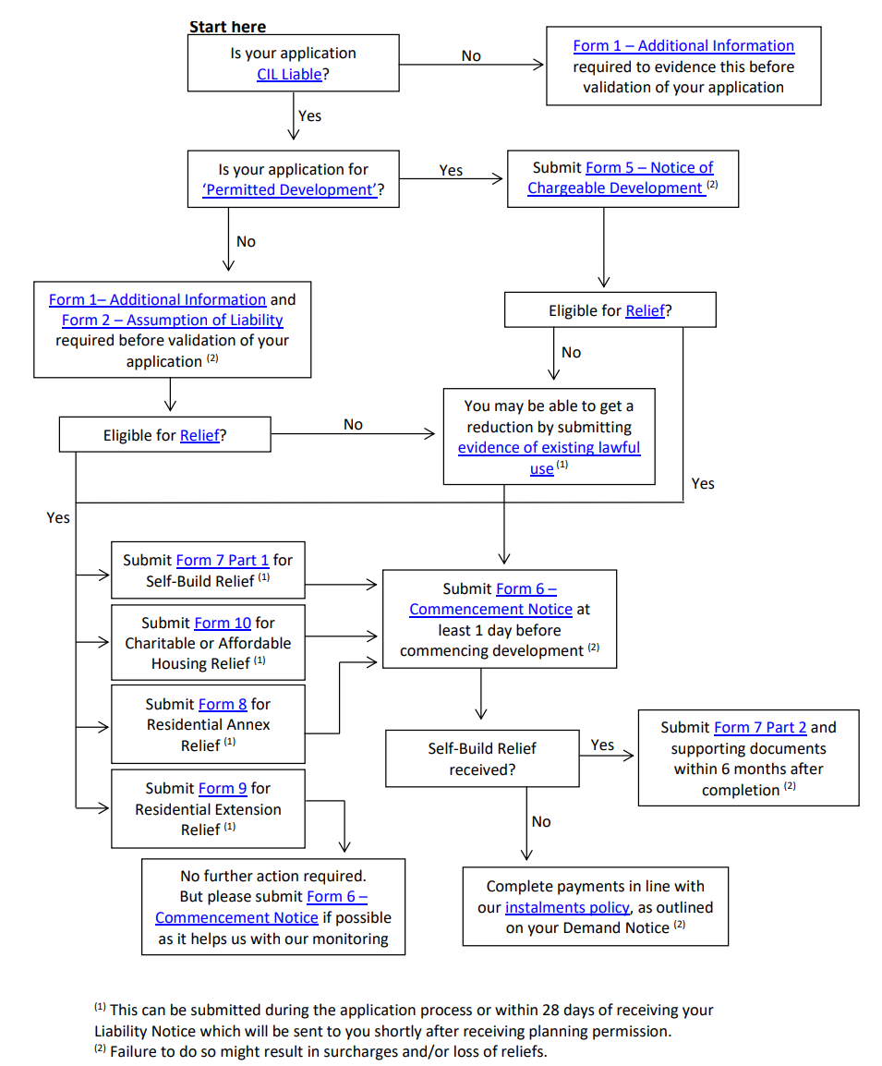
Customer Process to Complete CIL

Slide 13
S106 & CIL – A New WNC Approach
CIL & S106 a new WNC Approach
to be delivered:-
  Processes
  Allocation and Spending Policy Team
  Community Infrastructure Levy (CIL) Infrastructure List. It replaces the Regulation 123 list
  Governance and Legal Compliance
  Communications and Web Pages
  Historic Cases and Data
  S106 same elements will follow timescale TBC
Recent Highlights
Process review sessions have taken place
As is position reviewed
New process drafted
Checklist, instructions, protocol, technology and data
Training session Completed for mid January 2024
All to aid a consistent new WNC approach
Recruited 2x FTC staff dedicated to S106 data entry project
6x temporary staff from CBT provided to start CIL data review project 31/1/24

Slide 14
Local Engagement – how to help?
Creating strong communication between Councillors/Parishes and the Enforcement Team
Collaborative working
Consideration being given separate inbox for Councillors/Parish Cs for any S106 and CIL matters to allow you to you to communicate with us regarding local developments in the area.
Purpose of inbox is to enable you to provide local information of developments to act as an extension of the team. The information will then be reviewed with the team. This won’t be an additional avenue for communications, so responses will be automated. It is purely for intelligence gathering.
If you wish to raise a query, the current inboxes will remain.

Slide 15
QUESTIONS

